Slide 1

Hypergraphs with Bounded VC-Dimension
Shakhar Smorodinsky
IBS ECOPRO Summer School

Slide 2
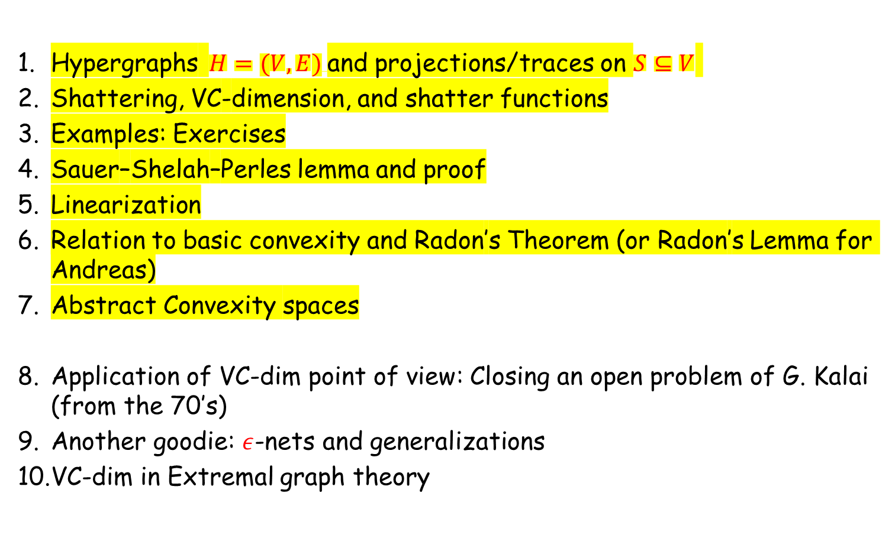
roadmap
Hypergraphs $H=(V,E)$and projections/traces on $S⊆V$
Shattering, VC-dimension, and shatter functions
Examples: Exercises
Sauer–Shelah–Perles lemma and proof
Linearization
Relation to basic convexity and Radon’s Theorem (or Radon’s Lemma for Andreas)
Abstract Convexity spaces
Application of VC-dim point of view: Closing an open problem of G. Kalai (from the 70’s)
Another goodie: $ε$-nets and generalizations
VC-dim in Extremal graph theory
Notes:
This slide is meant to orient the audience. Emphasize that Sauer-Shelah is the first real theorem and that examples are not just warm-up: they motivate the geometric applications.

Slide 3
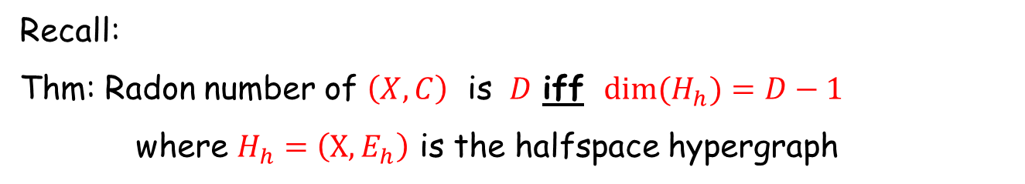
Separable Convexity spaces
Let $\left(X,C\right)$ be a separable abstract convexity space
Recall:
Thm: Radon number of $\left(X,C\right)$ is $D$ iff ${dim(H}_{h})=D−1$
where $H_{h}=\left(X,E_{h}\right)$ is the halfspace hypergraph

Slide 4


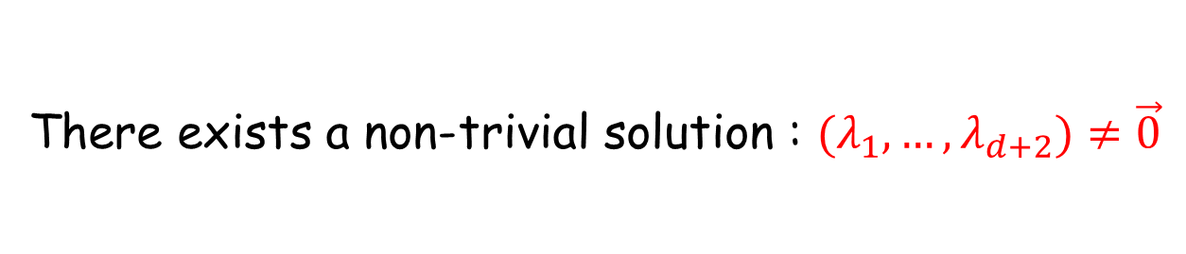

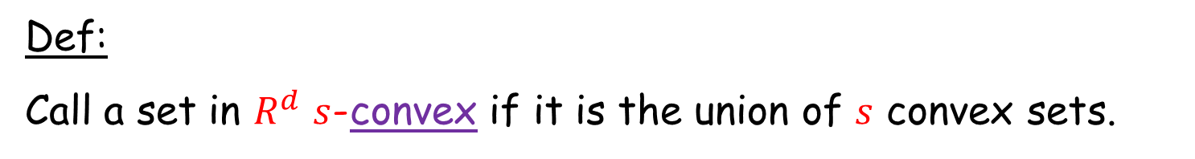
Union of convex sets
Def:
Call a set in $R^{d}$ $s$-convex if it is the union of $s$ convex sets.
2-convex
2-convex
3-convex

Slide 5
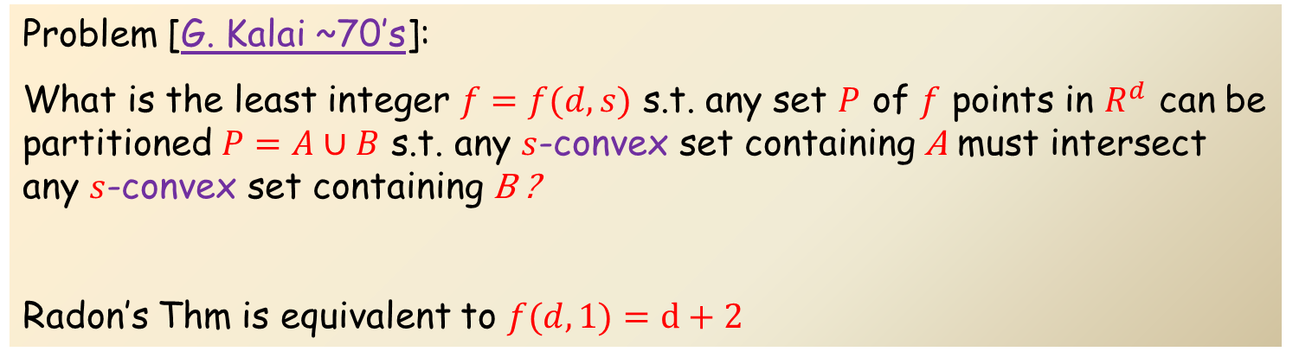
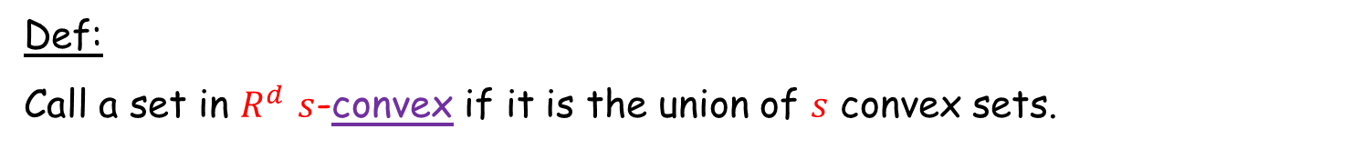
Kalai’s problem
Def:
Call a set in $R^{d}$ $s$-convex if it is the union of $s$ convex sets.
Problem [G. Kalai ~70’s]:
What is the least integer $f=f(d,s)$ s.t. any set $P$ of $f$ points in $R^{d}$ can be partitioned $P=A∪B$ s.t. any $s$-convex set containing A must intersect any $s$-convex set containing B ?
Radon’s Thm is equivalent to $f(d,1)=d+2$
Thm: [Bárány-Kalai ‘21 ]: $f(d,s)$exists! $f(d,s)≤{twr}_{d}(Θ(s))$
Thm: [Alon-S ‘26 ]: $f(d,s)=O(d{ s}^{2} log s)$
Thm: [Chen-Ge-Shu-Wang-Xu ’26 ]: $f\left(d,s\right)> ds^{2}$
Thm: [Ge-Shu-Xu ’26+ ]: $f\left(d,s\right)> ds^{2} log \left(s+1\right) ∀d≥4$

Slide 6
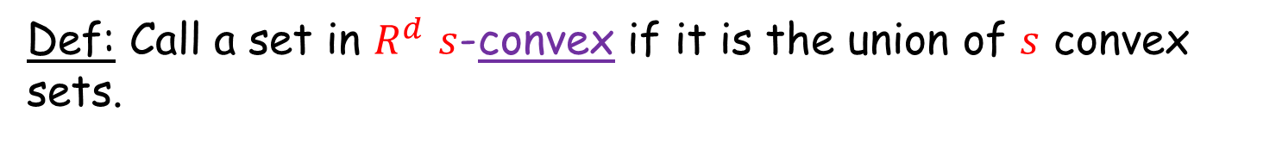
Kalai’s problem
Def: Call a set in $R^{d}$ $s$-convex if it is the union of $s$ convex sets.
Thm: [Alon-S ‘25 ]: $f(d,s)=O(ds^{2} log s)$
Def: Call a set $k$-nice if it can be expressed (unions and intersections) with $k$ half-spaces.
6-nice

Slide 7
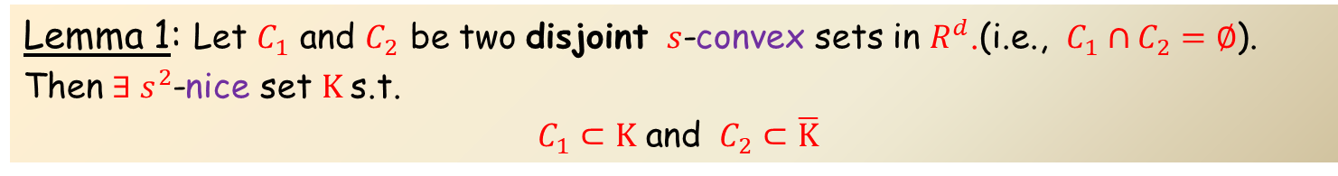
Kalai’s problem
Def: Call a set in $R^{d}$ $s$-convex if it is the union of $s$ convex sets.
Thm: [Alon-S ‘25 ]: $f(d,s)=O(ds^{2} log s)$
Lemma 1: Let $C_{1}$ and $C_{2}$ be two disjoint $s$-convex sets in $R^{d}$.(i.e., $C_{1}∩C_{2}=∅$).
Then $∃ s^{2}$-nice set $K$s.t.
$C_{1}⊂K$ and $C_{2}⊂\overline{K}$
Lemma 2: Let $H=\left(R^{d},E\right)$ where $A∈E$ iff $A$ is $s^{2}$-nice
Then $\dim\left(H\right)=O(ds^{2}\log{s})$

Slide 8
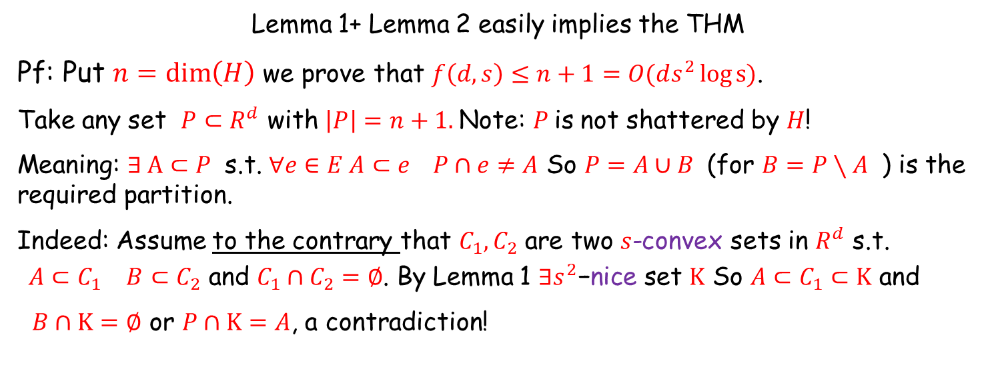
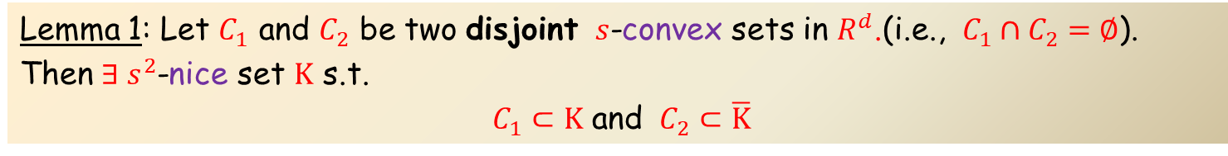
Kalai’s problem
Thm: [Alon-S ‘25 ]: $f(d,s)=O(ds^{2} log(s+1))$
Lemma 1: Let $C_{1}$ and $C_{2}$ be two disjoint $s$-convex sets in $R^{d}$.(i.e., $C_{1}∩C_{2}=∅$).
Then $∃ s^{2}$-nice set $K$ s.t.
$C_{1}⊂K$ and $C_{2}⊂\overline{K}$
Lemma 2: Let $H=\left(R^{d},E\right)$ where $A∈E$ iff $A$ is $s^{2}$-nice
Then $\dim\left(H\right)=O(ds^{2}\log{s})$
Lemma 1+ Lemma 2 easily implies the THM
Pf: Put $n=\dim\left(H\right)$ we prove that $f\left(d,s\right)≤n+1=O(ds^{2}\log{s})$.
Take any set $P⊂R^{d}$ with $\left|P\right|=n+1.$Note: $P$is not shattered by $H$!
Meaning: $∃ A⊂P$ s.t. $∀e∈E A⊂e P∩e≠A$ So $P=A∪B$ (for $B=P∖A$ ) is the required partition.
Indeed: Assume to the contrary that $C_{1}, C_{2}$ are two $s$-convex sets in $R^{d}$ s.t.
${A⊂C}_{1 } B⊂C_{2}$ and $C_{1}∩C_{2}=∅$. By Lemma 1 $∃s^{2}\text{−}\text{nice}\text{ set }K$ So ${A⊂C}_{1}⊂K$ and
$B∩K=∅$ or $P∩K=A$, a contradiction!

Slide 9
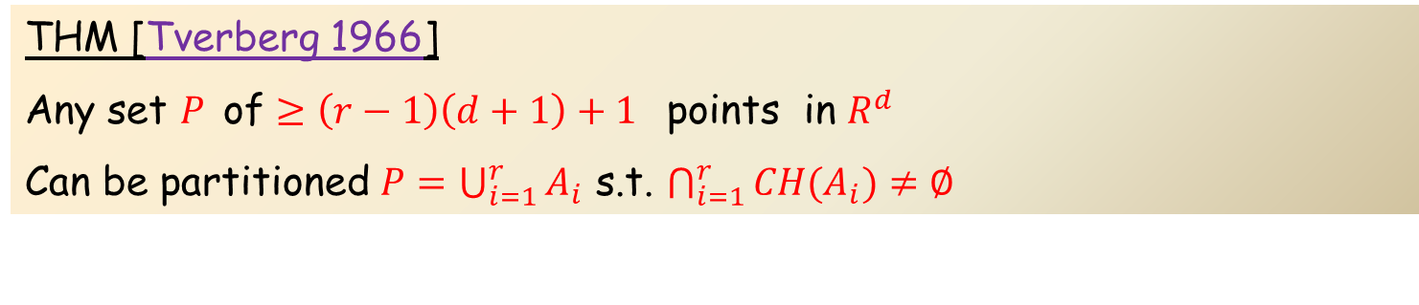
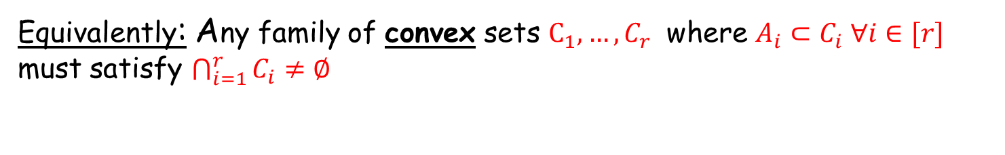
Extension of Radon
THM [Tverberg 1966]
Any set $P$of $≥\left(r−1\right)\left(d+1\right)+1$ points in $R^{d}$
Can be partitioned $P=\bigcup_{i=1}^{r}{A_{i}}$ s.t. $\bigcap_{i=1}^{r}{CH(A_{i})}≠∅$
Equivalently: Any family of convex sets $C_{1},…,C_{r}$ where ${A_{i}⊂C}_{i} ∀i∈[r]$ must satisfy $\bigcap_{i=1}^{r}{C_{i}}≠∅$

Slide 10
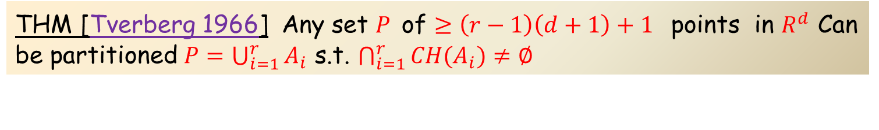
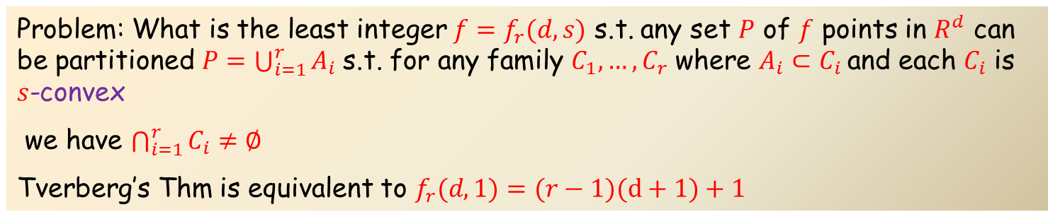
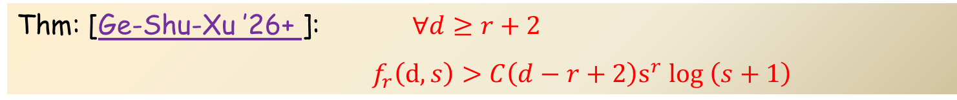
Extension of Tverberg
THM [Tverberg 1966] Any set $P$of $≥\left(r−1\right)\left(d+1\right)+1$ points in $R^{d}$ Can be partitioned $P=\bigcup_{i=1}^{r}{A_{i}}$ s.t. $\bigcap_{i=1}^{r}{CH(A_{i})}≠∅$
Problem: What is the least integer $f=f_{r}(d,s)$ s.t. any set $P$ of $f$ points in $R^{d}$ can be partitioned $P=\bigcup_{i=1}^{r}{A_{i}}$s.t. for any family $C_{1},…,C_{r}$ where $A_{i}⊂C_{i}$and each $C_{i}$ is $s$-convex
we have $\bigcap_{i=1}^{r}{C_{i}}≠∅$
Tverberg’s Thm is equivalent to $f_{r}(d,1)=(r−1)(d+1)+1$
Thm: [Alon-S ‘25 ]: $f_{r}(d,s)=O(dr^{2}\log{r} s^{r}\log{{(s}^{r})} )$
Thm: [Chen-Ge-Shu-Wang-Xu ’25+ ]: $∀ d≥2r−2$
${ f}_{r}\left(d,s\right)> {(d−2r+4)s}^{r}$
Thm: [Ge-Shu-Xu ’26+ ]: $∀d≥r+2$
$f_{r}\left(d,s\right)>C\left(d−r+2\right)s^{r} log \left(s+1\right)$

Slide 11
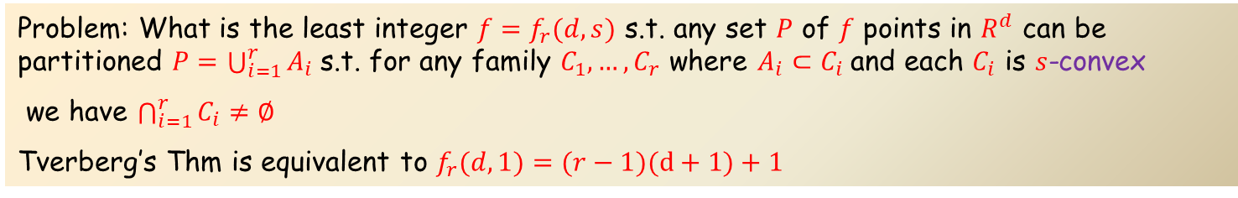
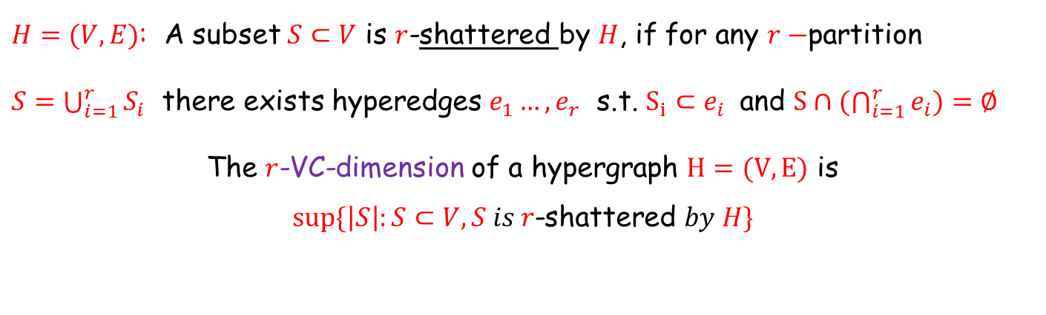
Extension of VC-dimension
Problem: What is the least integer $f=f_{r}(d,s)$ s.t. any set $P$ of $f$ points in $R^{d}$ can be partitioned $P=\bigcup_{i=1}^{r}{A_{i}}$s.t. for any family $C_{1},…,C_{r}$ where $A_{i}⊂C_{i}$and each $C_{i}$ is $s$-convex
we have $\bigcap_{i=1}^{r}{C_{i}}≠∅$
Tverberg’s Thm is equivalent to $f_{r}(d,1)=(r−1)(d+1)+1$
Thm: [Alon-S ‘25 ]: $f_{r}(d,s)=O(dr^{2}\log{r} s^{r}\log{{(s}^{r})})$
Key tool: we extend the notion of VC-dimension to $r$-VC-dimension
$H=(V,E)$: A subset $S⊂V$ is $r$-shattered by $H$, if for any $r−$partition
$S=\bigcup_{i=1}^{r}{S_{i}}$ there exists hyperedges $e_{1}…,e_{r}$ s.t. $S_{i}⊂e_{i}$ and $S∩(\bigcap_{i=1}^{r}{e_{i}})=∅$
The $r$-VC-dimension of a hypergraph $H=(V,E)$ is
$$sup⁡\{\left|S\right|:S⊂V, S is r\text{−shattered} by H\}$$

Slide 12
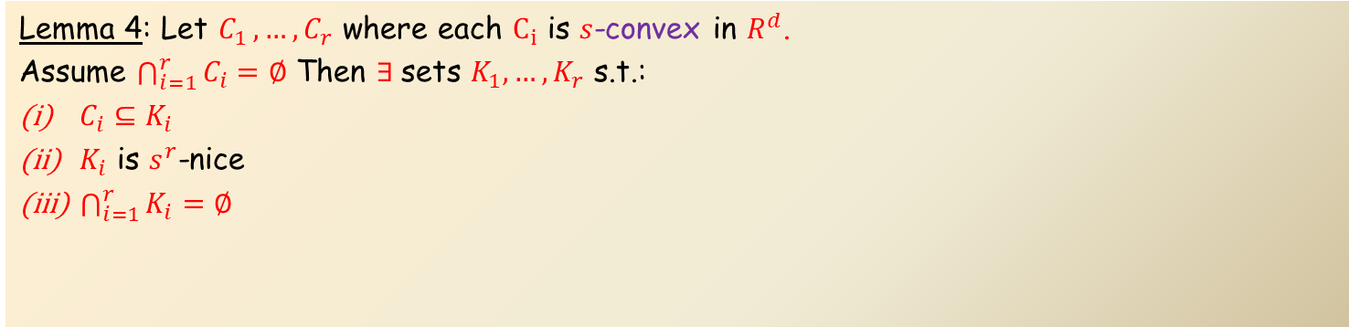
Extension of Tverberg
Thm: [Alon-S ‘25 ]: $f_{r}(d,s)=O(dr^{2}\log{r} s^{r}\log{{(s}^{r})})$
Lemma 3: Let $H=\left(V,E\right)$ where $\dim\left(H\right)=d$ Then $r−dim\left(H\right)=O(dr^{2}\log{r})$
Lemma 4: Let $C_{1 },…,C_{r}$ where each $C_{i}$ is $s$-convex in $R^{d}$.
Assume $\bigcap_{i=1}^{r}{C_{i}}=∅$ Then $∃$sets $K_{1},…,K_{r}$ s.t.:
$C_{i}⊆K_{i}$
$K_{i}$ is $s^{r}$-nice
$\bigcap_{i=1}^{r}{K_{i}}=∅$
Lemma 3+ Lemma 4 implies the THM

Slide 13
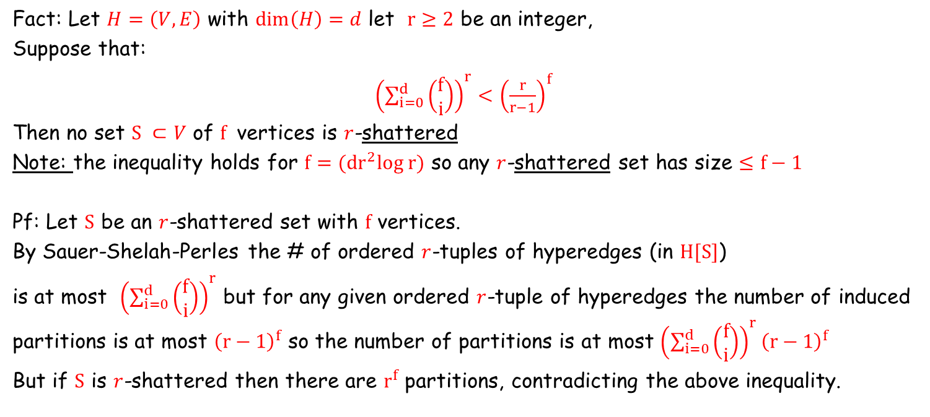
Proof of Lemma 3
Lemma 3: Let $H=\left(V,E\right)$ where $\dim\left(H\right)=d$ Then $r−dim\left(H\right)=O(dr^{2}\log{r})$
Fact: Let $H=\left(V,E\right)$ with $\dim\left(H\right)=d$ let $r≥2$ be an integer,
Suppose that:
${\left(\sum_{i=0}^{d}{\left(\begin{matrix}f \\ i\end{matrix}\right)}\right)}^{r}<{\left(\frac{r}{r−1}\right)}^{f}$
Then no set $S ⊂V$ of $f$ vertices is $r$-shattered
Note: the inequality holds for $f=(dr^{2}log r)$ so any $r$-shattered set has size $≤f−1$
Pf: Let $S$ be an $r$-shattered set with $f$ vertices.
By Sauer-Shelah-Perles the # of ordered $r$-tuples of hyperedges (in $H[S]$)
is at most ${\left(\sum_{i=0}^{d}{\left(\begin{matrix}f \\ i\end{matrix}\right)}\right)}^{r}$ but for any given ordered $r$-tuple of hyperedges the number of induced partitions is at most ${\left(r−1\right)}^{f}$ so the number of partitions is at most ${\left(\sum_{i=0}^{d}{\left(\begin{matrix}f \\ i\end{matrix}\right)}\right)}^{r}{\left(r−1\right)}^{f}$
But if $S$ is $r$-shattered then there are $r^{f}$ partitions, contradicting the above inequality.

Slide 14
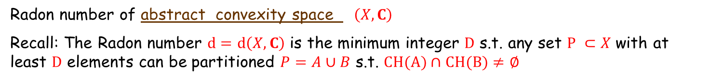
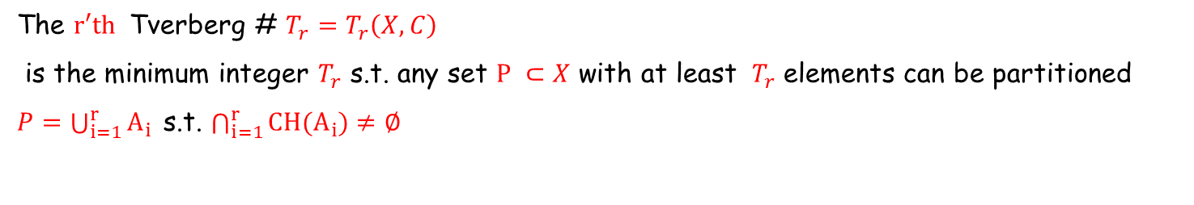
Related: Eckhoff’s Conjecture (1978)
Radon number of abstract convexity space $\left(X,C\right)$
Recall: The Radon number $d=d\left(X,C\right)$ is the minimum integer $D$ s.t. any set $P ⊂X$ with at least $D$ elements can be partitioned $P=A∪B$ s.t. $CH(A)∩CH(B)≠∅$
The $r′th$ Tverberg # $T_{r}=T_{r}\left(X,C\right)$
is the minimum integer $T_{r}$ s.t. any set $P ⊂X$ with at least $T_{r}$ elements can be partitioned
$P=\bigcup_{i=1}^{r}{A_{i} }$s.t. $\bigcap_{i=1}^{r}{{CH(A}_{i})}≠∅$

Slide 15

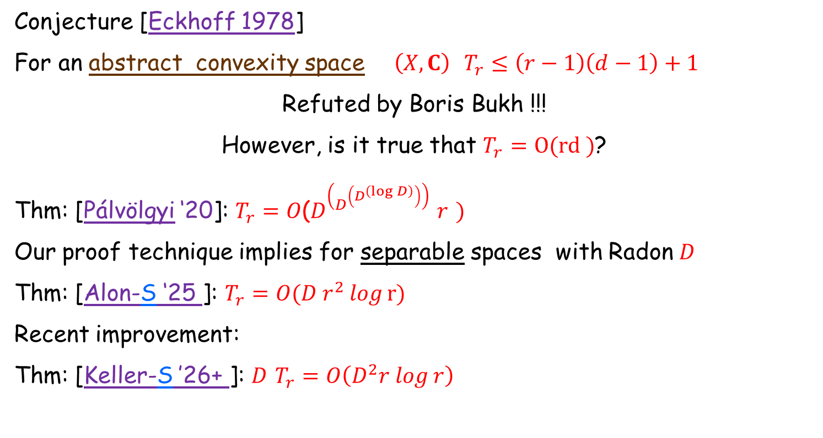
Related: Eckhoff’s Conjecture (1978)
The $r′th$ Tverberg # $T_{r}=T_{r}\left(X,C\right)$
is the minimum integer $T_{r}$ s.t. any set $P ⊂X$ with at least $T_{r}$ elements can be partitioned
$P=\bigcup_{i=1}^{r}{A_{i} }$s.t. $\bigcap_{i=1}^{r}{{CH(A}_{i})}≠∅$
Conjecture [Eckhoff 1978]
For an abstract convexity space $\left(X,C\right)$ $T_{r}≤\left(r−1\right)\left(d−1\right)+1$
Refuted by Boris Bukh !!!
However, is it true that $T_{r}=O(rd )$?
Thm: [Pálvölgyi ‘20]: $T_{r}=O$($D^{\left(D^{\left(D^{\left(\log{D}\right)}\right)}\right)}$ $r$ $)$
Our proof technique implies for separable spaces with Radon $D$
Thm: [Alon-S ‘25 ]: $T_{r}=O(D r^{2}log⁡r){⁡}$
Recent improvement:
Thm: [Keller-S ’26+ ]: $D$ $T_{r}=O\left(D^{2}r log⁡r\right)⁡⁡$

