Slide 1

Hypergraphs with Bounded VC-Dimension
Shakhar Smorodinsky
IBS ECOPRO Summer School

Slide 2
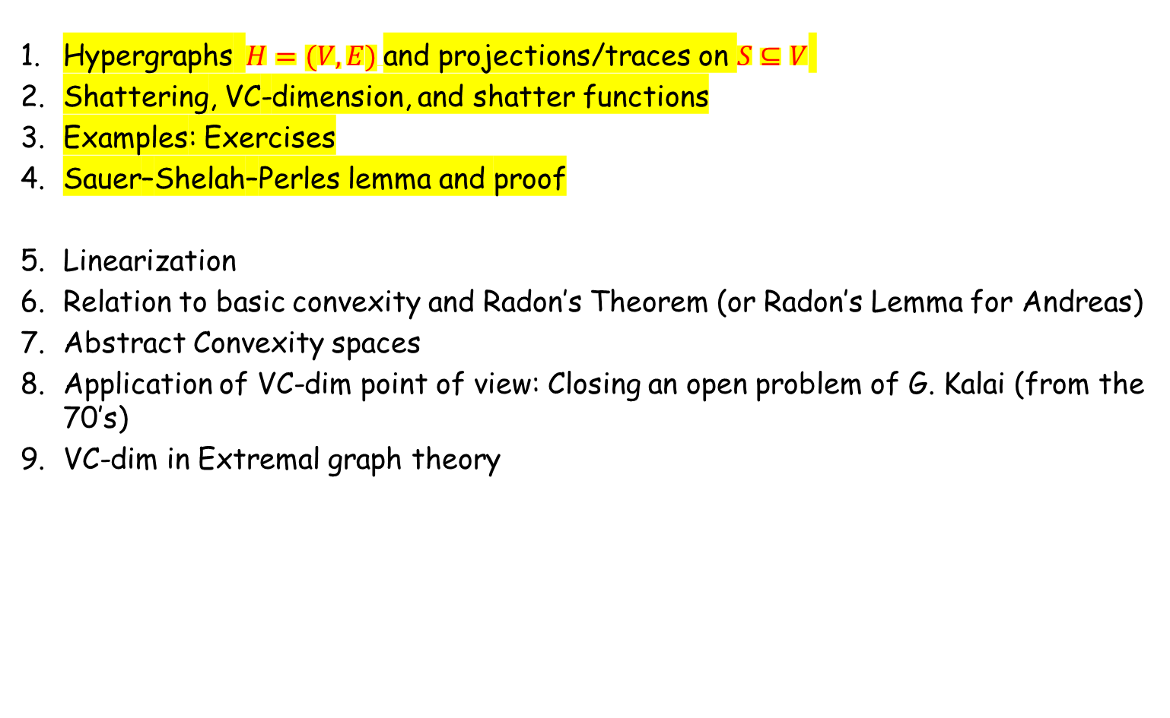
roadmap
Hypergraphs $H=(V,E)$and projections/traces on $S⊆V$
Shattering, VC-dimension, and shatter functions
Examples: Exercises
Sauer–Shelah–Perles lemma and proof
Linearization
Relation to basic convexity and Radon’s Theorem (or Radon’s Lemma for Andreas)
Abstract Convexity spaces
Application of VC-dim point of view: Closing an open problem of G. Kalai (from the 70’s)
VC-dim in Extremal graph theory
Notes:
This slide is meant to orient the audience. Emphasize that Sauer-Shelah is the first real theorem and that examples are not just warm-up: they motivate the geometric applications.

Slide 3

Polynomially-defined hypergraphs
Polynomial inequalities are a major source of bounded-VC hypergraphs.
Def: Fix $d,r≥1$. Let $P_{d,r}$ be all ranges of the form
{ x∈ℝᵈ : p(x) ≥ 0 }
where $p∈R\left[X_{1},...,X_{d}\right]$ is a $d$-variate real polynomial of total degree at most $r$.
Key trick: linearize by adding monomial coordinates.
Notes:
Start the Veronese subsection. This is important because it connects algebraic geometry-style ranges with ordinary halfspaces.

Slide 4

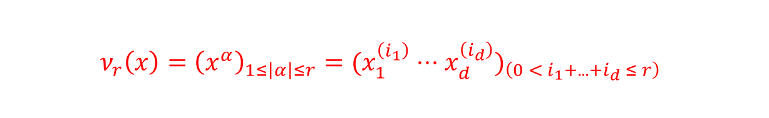

The Veronese map
The degree-$r$ Veronese map sends $x$ to all (non constant) monomials of degree $≤r$.
$$ν_{r}:Rᵈ→Rᴹ, M=\left({d+r \atop r}\right)−1$$
$$ν_{r}\left(x\right)={\left(x^{α}\right)}_{1≤\left|α\right|≤r}=(x_{1}^{\left(i_{1}\right)}⋅⋅⋅x_{d}^{\left(i_{d}\right)})_{\left(0 < i_{1}+...+i_{d} ≤ r\right)}$$
Example $d=2,r=2$:
(x,y) ↦ (x, y, x², xy, y²)
Notes:
Explain that M is the number of nonconstant monomials. Including the constant monomial makes the map linear through the origin, but affine halfspaces are more convenient.

Slide 5
Polynomial inequalities become halfspaces
Write a degree-$r$ polynomial as
$$p\left(x\right)=a₀+Σ_{1≤\left|α\right|≤r}a_{α}x^{α}$$
After the change of variables $z_{α}=x^{α}$:
$$p\left(x\right)≥0⇔a₀+Σa_{α}z_{α}≥0$$
Thus a polynomial range is the preimage of a halfspace under $ν_{r}$.
Notes:
This is the core of the Veronese argument. Draw a schematic: original space, Veronese lift, halfspace upstairs.

Slide 6


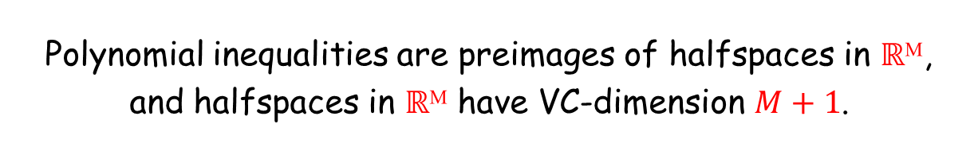
VC-dimension bound for polynomial ranges
Proof: For degree-r polynomial inequalities in ℝᵈ,
$$VC−dim\left(P_{d,r}\right)≤\left({d+r \atop r}\right)$$
Proof:
Polynomial inequalities are preimages of halfspaces in $ℝ$ᴹ,
and halfspaces in ℝᴹ have VC-dimension $M+1$.
$$M+1=\left({d+r \atop r}\right)$$
Notes:
This is the clean bounded VC dimension proof for algebraic ranges. Mention that the bound is often not sharp but is robust.

Slide 7
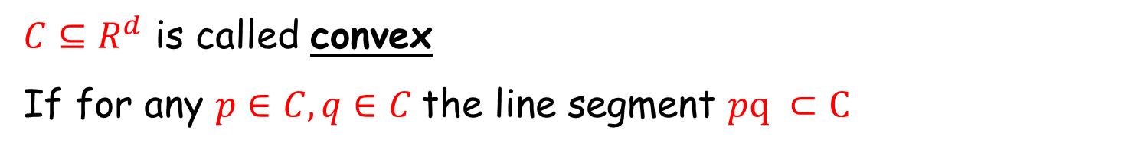

Convex sets in $R^{d}$
${C⊆R}^{d}$ is called convex
If for any $p∈C, q∈C$ the line segment $pq ⊂C$

Slide 8
Convex sets in $R^{d}$
${C⊆R}^{d}$ is called convex
If for any $p∈C, q∈C$ the line segment $pq ⊂C$
Note:
Intersection of convex sets is convex.

Slide 9
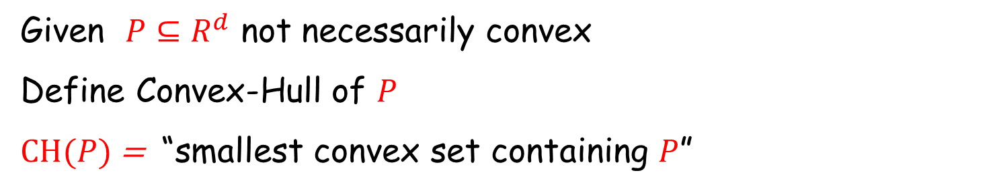
Convex sets in $R^{d}$
${C⊆R}^{d}$ is called convex
If for any $p∈C, q∈C$ the line segment $pq ⊂C$
Given ${P⊆R}^{d}$ not necessarily convex
Define Convex-Hull of $P$
$CH(P)$ = “smallest convex set containing $P$”

Slide 10
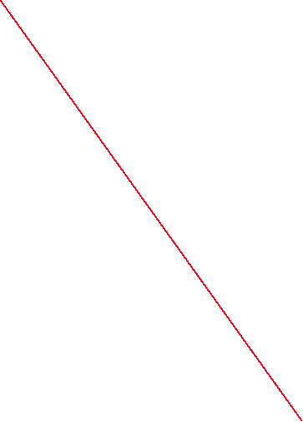
Convex sets in $R^{d}$
Separability

Slide 11

Exercise
Let $H=\left(V,E\right)$ be some points w.r.t convex sets
Exercise 6 :$dim\left(H\right)=?$

Slide 12

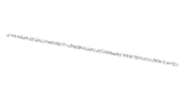




Radon’s Theorem
THM [Radon 1923] Any set $P$of $≥d+2$ points in $R^{d}$
Can be partitioned $P=A∪B$ s.t. $CH\left(A\right)∩CH\left(B\right)≠∅$
Equivalently: Any convex set containing A must intersect any convex set containing B

Slide 13
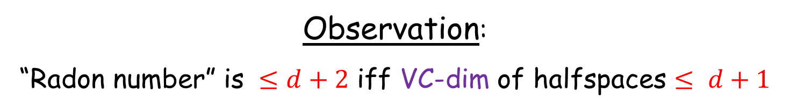
VC-dimension
Radon vs VC-dimension of points w.r.t halfspaces
Observation:
“Radon number” is $≤d+2$ iff VC-dim of halfspaces $≤ d+1$

Slide 14
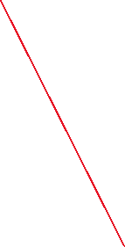




VC-dimension
Radon vs VC-dimension of points w.r.t halfspaces
Observation:
VC-dim of halfspaces $≤ d+1$ implies Radon’s thm
Consider $|P|=d+2.$ Hence, $P$ cannot be shattered.
So $∃ A⊂P$s.t. there is NO halfspace $h$ with $h∩P=A$
Meaning $CH(A)$ and $CH(P∖A)$ cannot be disjoint for otherwise …
$$CH(P∖A)$$
$$CH(A)$$

Slide 15

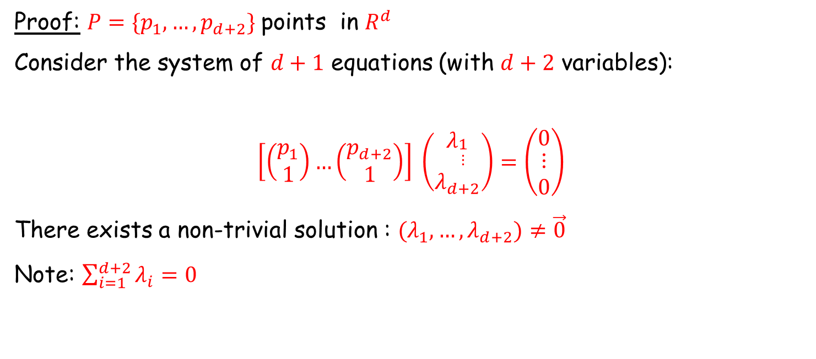
Proof: Radon’s Theorem
THM [Radon 1923] Any set $P$of $≥d+2$ points in $R^{d}$
Can be partitioned $P=A∪B$ s.t. $CH\left(A\right)∩CH\left(B\right)≠∅$
Proof: $P=\{p_{1},…,p_{d+2}\}$points in $R^{d}$
Consider the system of $d+1$ equations (with $d+2$ variables):
$$\left[\left(\begin{matrix}p_{1} \\ 1\end{matrix}\right)…\left(\begin{matrix}p_{d+2} \\ 1\end{matrix}\right)\right] \left(\begin{matrix}λ_{\begin{aligned}1 \\ ⋮\end{aligned}} \\ λ_{d+2}\end{matrix}\right)=\left(\begin{matrix}0 \\ \begin{aligned}⋮ \\ 0\end{aligned}\end{matrix}\right)$$
There exists a non-trivial solution : ${(λ}_{1},…,λ_{d+2})≠\vec{0}$
Note: $\sum_{i=1}^{d+2}{λ_{i}=0}$

Slide 16




Proof: Radon’s Theorem
There exists a non-trivial solution : ${(λ}_{1},…,λ_{d+2})≠\vec{0}$
Put $I_{1}=\left\{i∈\left[d+2\right] \right|{ λ}_{i}>0\}$ and ${ I}_{2}= \left\{i∈\left[d+2\right] \right|{ λ}_{i}< 0\}$
$$\sum_{i∈I_{1}}{λ_{i}p_{i}+ \sum_{j∈I_{2}}{λ_{j}p_{j}}}= \vec{0}$$
$$x=\sum_{i∈I_{1}}{λ_{i}p_{i}= −\sum_{j∈I_{2}}{λ_{j}p_{j}}}$$
Put $λ=\sum_{i∈I_{1}}{λ_{i}}$
so $\frac{x}{λ}=\sum_{i∈I_{1}}{\frac{λ_{i}}{λ}p_{i}= \sum_{j∈I_{2}}{\frac{{−λ}_{j}}{λ}p_{j}}}$
$$∈CH(\left\{p_{i}\right|i∈I_{2}\})$$
$$∈CH(\left\{p_{i}\right|i∈I_{1}\})$$

Slide 17


Helly from Radon
THM [Helly 1923]: Let $C₁,…,Cₘ$ be convex sets in $ℝᵈ$.
If every $d+1$ of them intersect, then
$$C₁∩C₂∩···∩Cₘ≠∅.$$
Equivalently: if the total intersection is empty,
some $d+1$ members already have an empty intersection.
Proof idea: Induction on $m≥d+2$

Slide 18
Proof
Enough to prove the base case $m=d+2. C_{1},…,C_{d+2}$
For each $i$ there exists a witness
$$xᵢ∈⋂_{j≠i}Cⱼ$$
We can assume the points $x₁,…,x_{d+2}$ are distinct... (why?)
Apply Radon to $x₁,…,x_{d+2}.$

Slide 19
Proof:
Radon gives a partition $X=A∪B$ with
$$CH\left(A\right)∩CH\left(B\right)≠∅.$$
Choose $z∈CH\left(A\right)∩CH\left(B\right).$
Claim: $z∈Cᵢ$ for every $i$

Slide 20
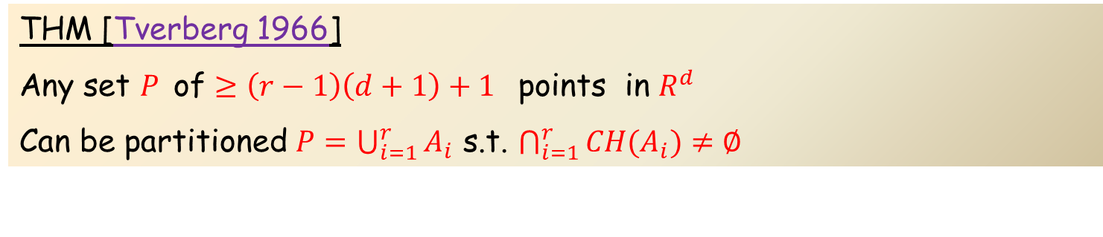
Extension of Radon to: partitions with more parts
THM [Tverberg 1966]
Any set $P$of $≥\left(r−1\right)\left(d+1\right)+1$ points in $R^{d}$
Can be partitioned $P=\bigcup_{i=1}^{r}{A_{i}}$ s.t. $\bigcap_{i=1}^{r}{CH(A_{i})}≠∅$

Slide 21
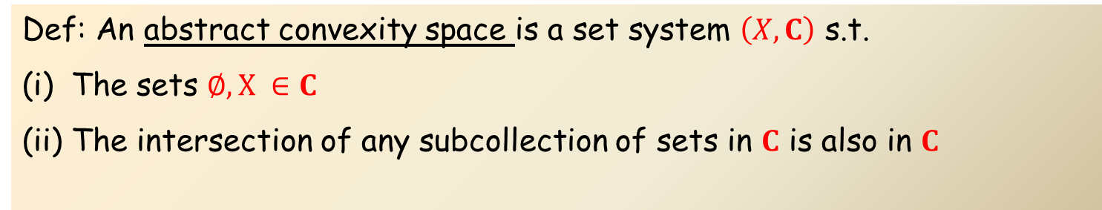
Abstract Convexity Spaces
Def: An abstract convexity space is a set system $\left(X,C\right)$ s.t.
The sets $∅, X ∈C$
The intersection of any subcollection of sets in $C$ is also in $C$

Slide 22
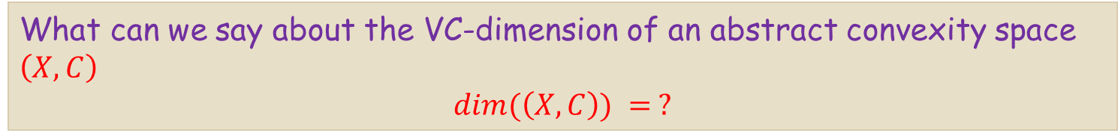
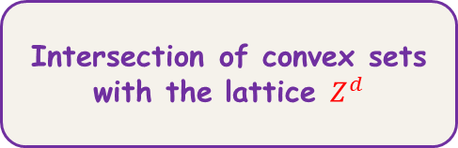
Examples of convexity spaces
Euclidean convexity
in ℝᵈ
Intersection of convex sets with the lattice $Z^{d}$
interval convexity
on a graph
The definitions make sense without coordinates, linear algebra, or topology.
What can we say about the VC-dimension of an abstract convexity space $\left(X,C\right)$
$$dim(\left(X,C\right)) = ?$$
Yet there is an interesting connection to VC-dimension!
we need a separation axiom
This is the abstraction behind “halfspaces separate disjoint convex set”.

Slide 23
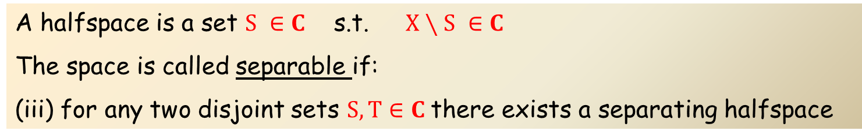
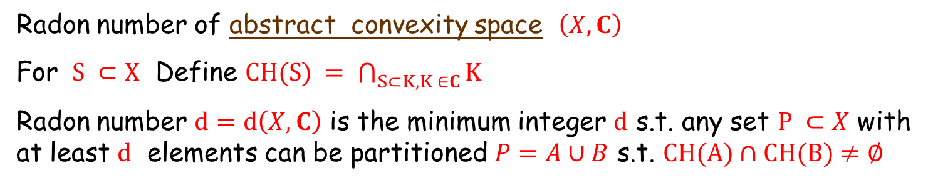
Abstract Convexity Spaces
Def: An abstract convexity space is a set system $\left(X,C\right)$ s.t.
The sets $∅, X ∈C$
The intersection of any subcollection of sets in $C$ is also in $C$
A halfspace is a set $S ∈C$ s.t. $X∖S ∈C$
The space is called separable if:
(iii) for any two disjoint sets $S, T∈C$there exists a separating halfspace
Radon number of abstract convexity space $\left(X,C\right)$
For $S ⊂X$ Define $CH(S) = \bigcap_{S⊂K,K ∈C}{K}$
Radon number $d=d\left(X,C\right)$ is the minimum integer $d$ s.t. any set $P ⊂X$ with at least $d$ elements can be partitioned $P=A∪B$ s.t. $CH(A)∩CH(B)≠∅$

Slide 24
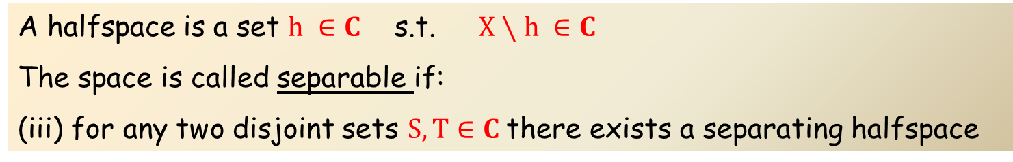
Halfspaces in an abstract convexity space
A halfspace is a set $h ∈C$ s.t. $X∖h ∈C$
The space is called separable if:
(iii) for any two disjoint sets $S, T∈C$there exists a separating halfspace
In ℝᵈ this contains the family of all open and closed affine halfspaces.

Slide 25



Exercise
A halfspace is a set $h ∈C$ s.t. $X∖h ∈C$
The space is called separable if:
(iii) for any two disjoint sets $S, T∈C$there exists a separating halfspace
Exercise 7: How many halfspaces are there in interval convexity on a tree with $n$ vertices?

Slide 26
Halfspaces in an abstract convexity space
A halfspace is a set $h ∈C$ s.t. $X∖h ∈C$
The space is called separable if:
(iii) for any two disjoint sets $S, T∈C$there exists a separating halfspace
The halfspace hypergraph of $\left(X,C\right)$is
$$H_{h}=\left(X,E_{h}\right), E_{h}=\left\{h:h is a halfspace\right\}$$

Slide 27
Recall
For $R^{d}$ Radon vs VC-dimension of points w.r.t halfspaces
“Radon number” is $d+2$ iff VC-dim of halfspaces $d+1$

Slide 28

Separable Convexity spaces
Let $\left(X,C\right)$ be a separable abstract convexity space
Thm: Radon number of $\left(X,C\right)$ is $D$ iff ${dim(H}_{h})=D−1$
where $H_{h}=\left(X,E_{h}\right)$ is the halfspace hypergraph

Slide 29


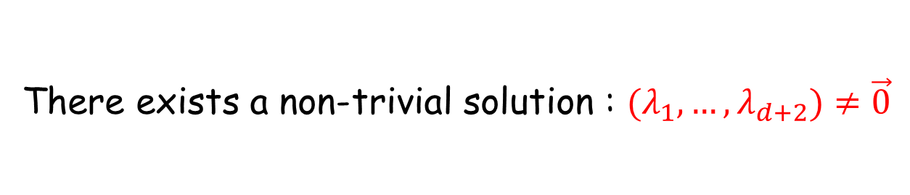

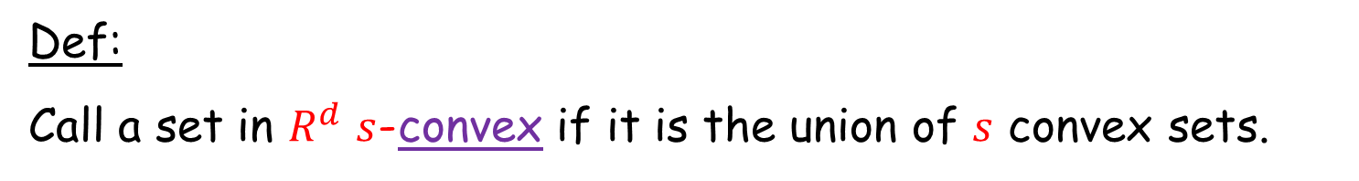
Union of convex sets
Def:
Call a set in $R^{d}$ $s$-convex if it is the union of $s$ convex sets.
2-convex
2-convex
3-convex

Slide 30
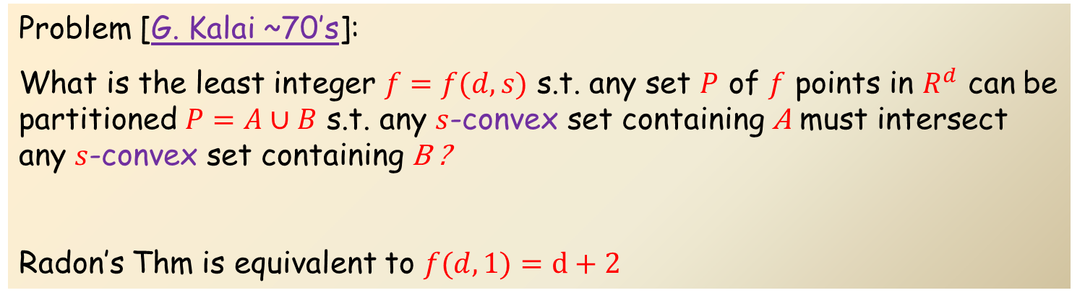
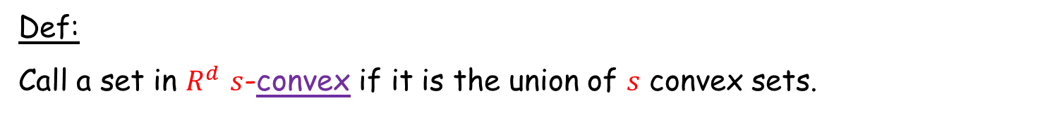
Kalai’s problem
Def:
Call a set in $R^{d}$ $s$-convex if it is the union of $s$ convex sets.
Problem [G. Kalai ~70’s]:
What is the least integer $f=f(d,s)$ s.t. any set $P$ of $f$ points in $R^{d}$ can be partitioned $P=A∪B$ s.t. any $s$-convex set containing A must intersect any $s$-convex set containing B ?
Radon’s Thm is equivalent to $f(d,1)=d+2$
Thm: [Bárány-Kalai ‘21 ]: $f(d,s)$exists! $f(d,s)≤{twr}_{d}(Θ(s))$
Thm: [Alon-S ‘26 ]: $f(d,s)=O(d{ s}^{2} log s)$
Thm: [Chen-Ge-Shu-Wang-Xu ’26 ]: $f\left(d,s\right)> ds^{2}$
Thm: [Ge-Shu-Xu ’26+ ]: $f\left(d,s\right)> ds^{2} log \left(s+1\right) ∀d≥4$

