Slide 1

Hypergraphs with Bounded VC-Dimension
Shakhar Smorodinsky
IBS ECOPRO Summer School

Slide 2
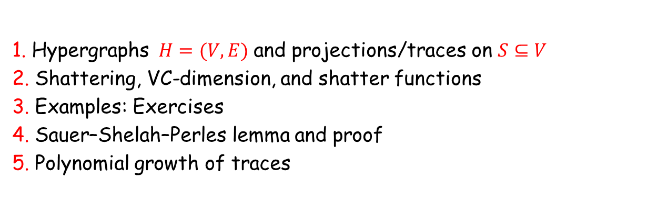
roadmap
Goal: introduce bounded VC-dimension as a quantitative notion of combinatorial simplicity.
1. Hypergraphs $H=(V,E)$and projections/traces on $S⊆V$
2. Shattering, VC-dimension, and shatter functions
3. Examples: Exercises
4. Sauer–Shelah–Perles lemma and proof
5. Polynomial growth of traces
Notes:
This slide is meant to orient the audience. Emphasize that Sauer-Shelah is the first real theorem and that examples are not just warm-up: they motivate the geometric applications.

Slide 3


Shatter function
The trace (projection) of E on $S⊆V$denoted $E_{S}$ is $\left\{ e∩S\right|e∈E\}$
The shatter function is
$π_{H}\left(m\right)=$ $\max_{S⊆V, \left|S\right|=m}{\{|E_{S}|\}}$
Obviously: $π_{H} (m) ≤ 2^{m}$
$$dim⁡(H) ≥d ⇔ π_{H}(d) = 2^d$$
12
Notes:
This formulation is useful because all later closure and counting arguments only count traces.

Slide 4
Example
points in the plane w.r.t discs

Slide 5
Example
points in the plane w.r.t axis-parallel boxes

Slide 6

The Shatter Lemma (Sauer–Shelah–Perles Lemma)
Lemma: [Sauer–Shelah–Perles ’72]
Let H=(V,E) with dim(H)=d. Then,
$$π_{H}\left(m\right) ≤\sum_{i=0}^{m}{\left(\begin{matrix}m \\ i\end{matrix}\right)}$$
Bounded VC-dim ⇒ polynomial number of traces.
Notes:
State this slowly. It is the core theorem of Lecture 1. Mention that the original lemma has several equivalent formulations.

Slide 7



Proof of Sauer–Shelah–Perles
It is enough to consider finite hypergraphs on [n].
$$M(n,d) = max⁡\left\{|E| : H=([n],E), dim(H)≤d\right\}$$
We prove by induction on $n$and $d$:
$$M(n,d) ≤\sum_{i=0}^{d}{\left(\begin{matrix}m \\ i\end{matrix}\right)}$$
Base cases: d=0 or n=0.
Notes:
This slide sets up the standard induction. Keep the proof on slides but do the key logic on the board.

Slide 8

Proof: split by a vertex
$E_{0}=\left\{e∩\left[n−1\right] \right| e∈E \}$
$${ E}_{1}=\left\{S⊆[n−1] \right| S∈E, S∪\{n\} ∈E\}$$
$${|E|=|E}_{0}|+{|E}_{1}|$$
E₀ records which traces appear at least once.
E₁ records which traces appear both with and without n.
Notes:
The subtlety is that E0 and E1 are hypergraphs on n-1 vertices. E1 counts duplicate pairs that differ only on x.

Slide 9
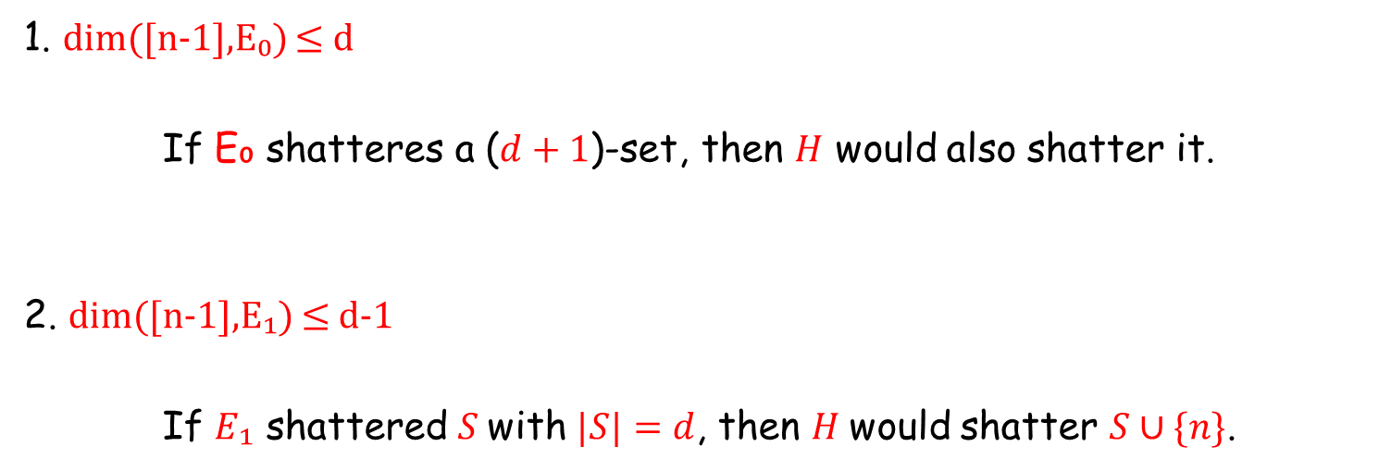
Proof: VC-dimensions of $E₀$ and $E₁$
1. dim([n-1],E₀) ≤ d
If E₀ shatteres a ($d+1$)-set, then $H$ would also shatter it.
2. dim([n-1],E₁) ≤ d-1
If $E₁$ shattered $S$with $|S|=d$, then $H$would shatter $S∪\{n\}$.
Notes:
Spend time here. For E1, explain how both choices of x are available for every pattern on S.

Slide 10

Proof: induction
By induction:
$$|E₀| ≤\sum_{i=0}^{ d}{\left(\begin{matrix}n−1 \\ i\end{matrix}\right)} and |E₁| ≤\sum_{i=0}^{d−1}{\left(\begin{matrix}n−1 \\ i\end{matrix}\right)}$$
Therefore
$$\left|E\right|≤\sum_{i=0}^{ d}{\left(\begin{matrix}n−1 \\ i\end{matrix}\right)}+\sum_{i=0}^{d−1}{\left(\begin{matrix}n−1 \\ i\end{matrix}\right)}=\sum_{i=0}^{d}{\left(\begin{matrix}n \\ i\end{matrix}\right)}$$
by Pascal’s identity.
Notes:
Finish the proof quickly after the previous slide. The important part is the induction split.

Slide 11
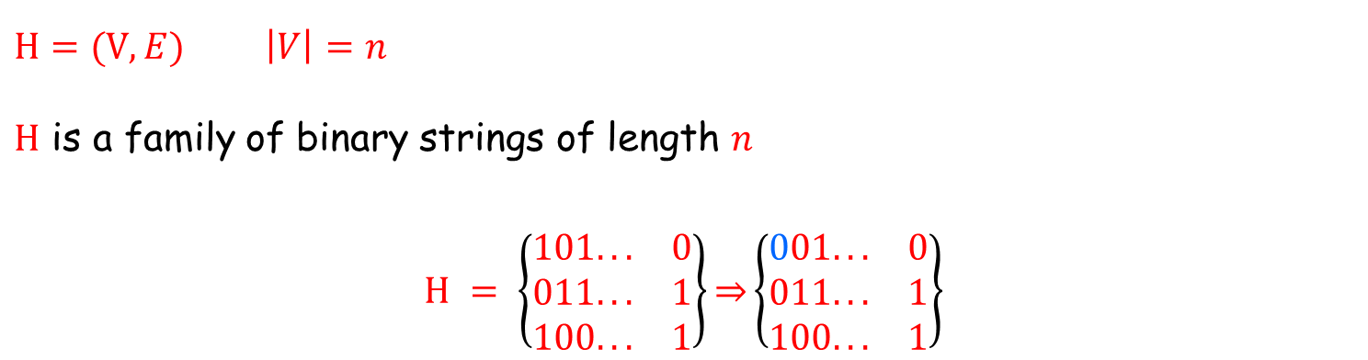
Another proof: compression
$H=(V,E)$ $\left|V\right|=n$
$H$ is a family of binary strings of length $n$
$$H = \left\{\begin{matrix}101... & 0 \\ 011... & 1 \\ 100... & 1\end{matrix}\right\}\underset{⇒}{}\left\{\begin{matrix}001... & 0 \\ 011... & 1 \\ 100... & 1\end{matrix}\right\}$$

Slide 12
First consequence
If $dim⁡(H)≤d$, then for every finite $S⊆V$:
$$\left|E_{S}\right|≤ {\left(\frac{e\left|S\right|}{d}\right)}^{d}=O_{d}({\left|S\right|}^{d})$$
So the number of different restrictions to $m$vertices is $O(m^{d})$.
This conversion from “no shattering” to counting is a key tool
behind many results on hypergraphs with bounded VC-dim.
Notes:
End Lecture 1 by previewing the closure theorem. This makes the next lecture feel inevitable.

Slide 13


Exercise
For $H=\left(V,E\right)$
Define: $H_{2}=\left(\left({V \atop 2}\right), E_{2}\right) E_{2}≔\left\{\left({S \atop 2}\right) ∣ S∈E\right\}$
Exercise 5 :$dim\left(H\right)=d \overset{⇒}{ } dim⁡\left(H_{2}\right)=O\left(d\right)$

Slide 14
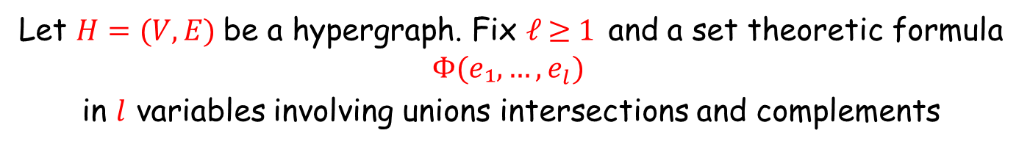

Boolean enrichment
Let $H=(V,E)$be a hypergraph. Fix ℓ ≥ 1 and a set theoretic formula $Φ(e₁,…,e_{l})$
in $l$ variables involving unions intersections and complements
Consider the hypergrph
$$H^{Φ}=\left(V,E_{Φ}\right)$$
Where $E_{Φ}=\left\{Φ\left(e_{1},…,e_{l}\right)\right|{ e}_{i}∈E ∀i∈[l]\}$
Example:
Points w.r.t triangles in the plane
Notes:
Fix notation H^(ell). Make clear that the theorem is insensitive to the exact model of bounded Boolean complexity.

Slide 15
Closure under bounded Boolean operations
THM: If $dim⁡(H)≤d$ then $dim⁡(H^{Φ}) = O(d ℓ log⁡ℓ).$
Main idea:
A trace of $H^{Φ}$on S is obtained from at most $ℓ$ traces of $H$ on S.
Count possible traces and compare with ${ 2}^{S}$
Notes:
This is the most important theorem of Lecture 2. Stress that it is an application of Sauer-Shelah plus a counting argument.

Slide 16
Proof of closure theorem
Let S⊆V with |S|=m.
By Sauer–Shelah–Perles:
|E| ≤ C_{d} m^{d}
A trace of $E_{Φ}$is determined by:
at most ℓ traces from E
$|E_{Φ}|$≤ $O\left({\left(m^{d}\right)}^{l}\right)=O\left(m^{dl}\right)$
Notes:
Explain that A_ell is the number of allowed formulas. If formulas have length O(ell), A_ell is exponential in ell, not doubly exponential.

Slide 17

Proof: compare with shattering
If S is shattered by $H^{Φ}$then
2^{m} ≤ $O\left(m^{dl}\right)$
Thus $m=O(d ℓ log⁡ℓ).$
Notes:
Do the inequality on the board. If needed, say that if m is much larger than d ell log ell then the right-hand side is too small.

