Slide 1

Hypergraphs with Bounded VC-Dimension
Shakhar Smorodinsky
IBS ECOPRO Summer School

Slide 2
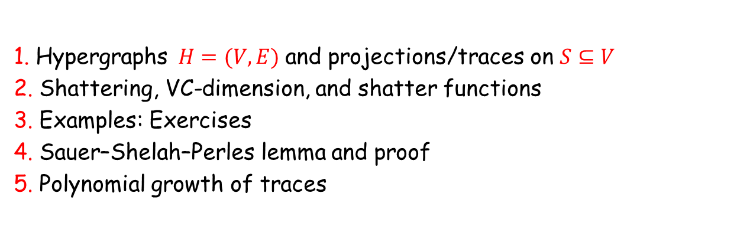
roadmap
Goal: introduce bounded VC-dimension as a quantitative notion of combinatorial simplicity.
1. Hypergraphs $H=(V,E)$and projections/traces on $S⊆V$
2. Shattering, VC-dimension, and shatter functions
3. Examples: Exercises
4. Sauer–Shelah–Perles lemma and proof
5. Polynomial growth of traces
Notes:
This slide is meant to orient the audience. Emphasize that Sauer-Shelah is the first real theorem and that examples are not just warm-up: they motivate the geometric applications.

Slide 3
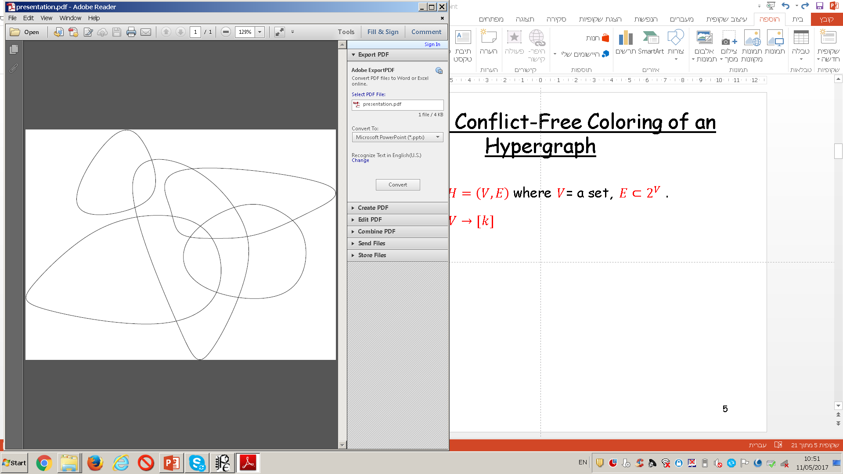

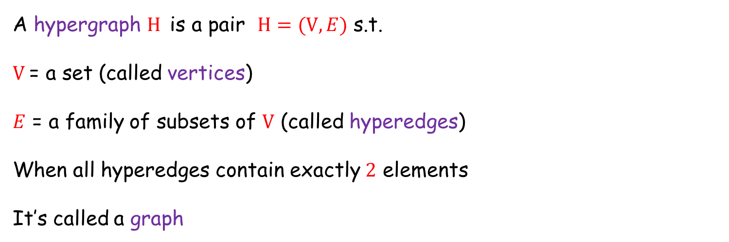
Hypergraphs
A hypergraph $H$is a pair $H=(V,E)$ s.t.
$V$= a set (called vertices)
$E$ = a family of subsets of $V$ (called hyperedges)
When all hyperedges contain exactly $2$ elements
It’s called a graph
$$H=(V,E)$$

Slide 4
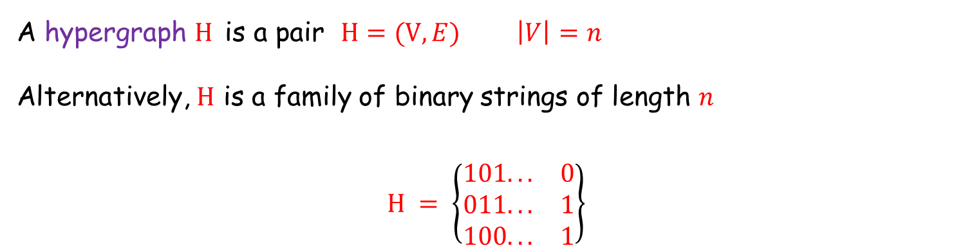
Hypergraphs
A hypergraph $H$is a pair $H=(V,E)$ $\left|V\right|=n$
Alternatively, $H$ is a family of binary strings of length $n$
$$H = \left\{\begin{matrix}101... & 0 \\ 011... & 1 \\ 100... & 1\end{matrix}\right\}$$

Slide 5
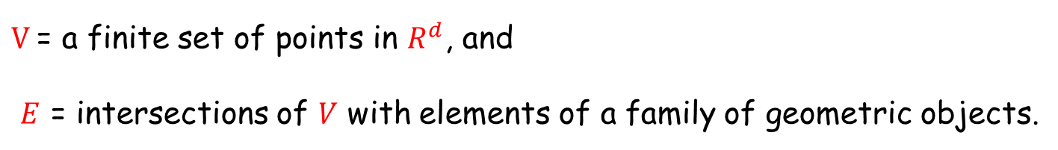
Example
$V$= a finite set of points in $R^{d}$, and
$E$ = intersections of $V$ with elements of a family of geometric objects.
points on a line w.r.t intervals

Slide 6
Example
points in the plane w.r.t discs

Slide 7
Example
points in the plane w.r.t axis-parallel boxes

Slide 8
Example
points in $R^{d}$w.r.t halfspaces

Slide 9
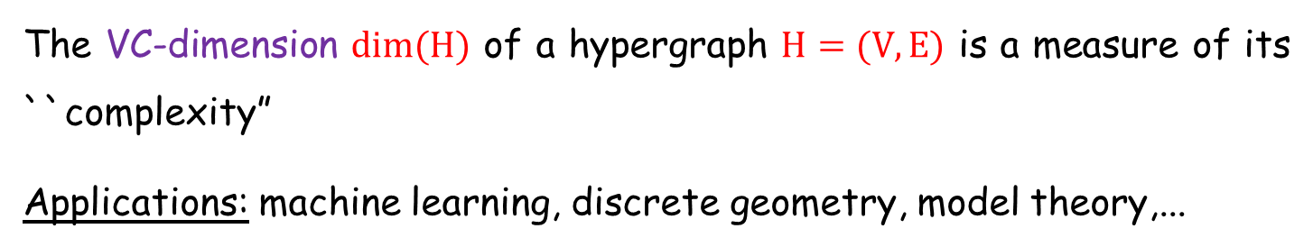
$$VC−dimension$$
The VC-dimension $dim(H)$ of a hypergraph $H=(V,E)$ is a measure of its ``complexity”
Applications: machine learning, discrete geometry, model theory,...
Many computational/combinatorial problems become easier when the underlying hypergraph has ``small” VC-dimension.
e.g., the integrality-gap of the underlying optimization problem (hitting-set/set-cover etc) is better.

Slide 10

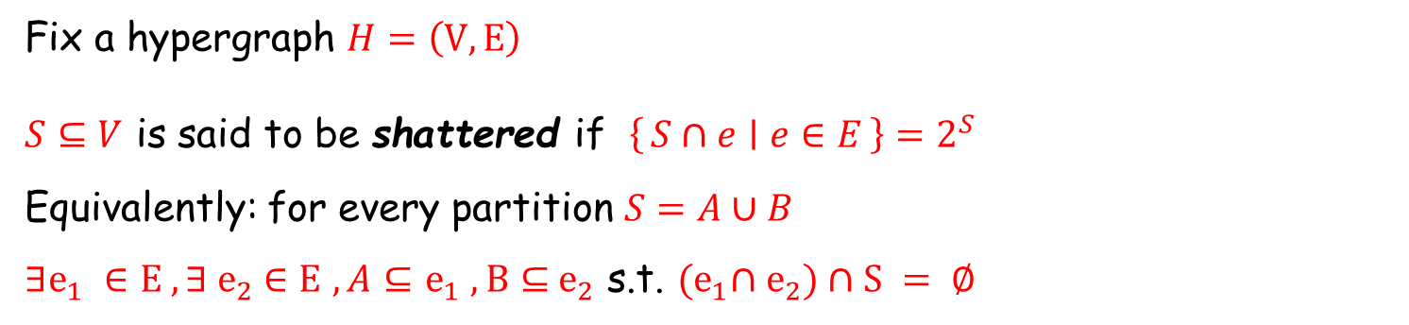
Definition: $VC−dimension$
Fix a hypergraph $H=\left(V,E\right)$
$S⊆V$ is said to be shattered if $\left\{S∩e ∣ e∈E\right\}=2^{S}$
Equivalently: for every partition $S=A∪B$
$∃e_{1} ∈E , {∃ e}_{2} ∈E$ $, A⊆$ $e_{1} , B⊆{ e}_{2}$ s.t. ${(e}_{1}∩{ e}_{2})∩S = ∅$

Slide 11
Definition: $VC−dimension$
Fix a hypergraph $H=\left(V,E\right)$
$S⊆V$ is said to be shattered if $\left\{S∩e ∣ e∈E\right\}=2^{S}$
Equivalently: for every partition $S=A∪B$
$∃e_{1} ∈E , {∃ e}_{2} ∈E$ $, A⊆$ $e_{1} , B⊆{ e}_{2}$ s.t. ${(e}_{1}∩{ e}_{2})∩S = ∅$

Slide 12
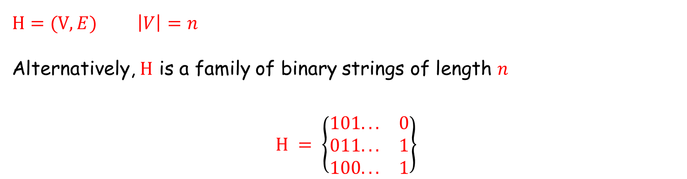
Another view of shattered set
$H=(V,E)$ $\left|V\right|=n$
Alternatively, $H$ is a family of binary strings of length $n$
$$H = \left\{\begin{matrix}101... & 0 \\ 011... & 1 \\ 100... & 1\end{matrix}\right\}$$

Slide 13
Definition: $VC−dimension$
The VC-dimension $dim⁡(H) = \max{ \left\{ \left|S\right|∣ S⊆V S is shattered\right\}}$

Slide 14
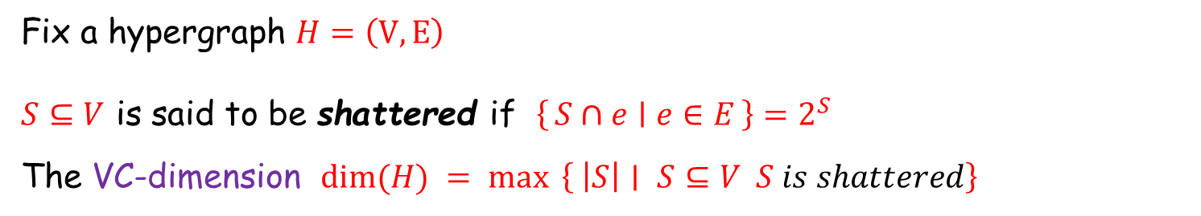
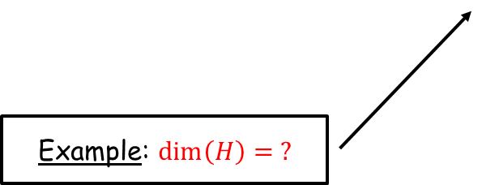
Definition: $VC−dimension$
Fix a hypergraph $H=\left(V,E\right)$
$S⊆V$ is said to be shattered if $\left\{S∩e ∣ e∈E\right\}=2^{S}$
The VC-dimension $dim⁡(H) = \max{ \left\{ \left|S\right|∣ S⊆V S is shattered\right\}}$
Example: $\dim\left(H\right)= ?$

Slide 15
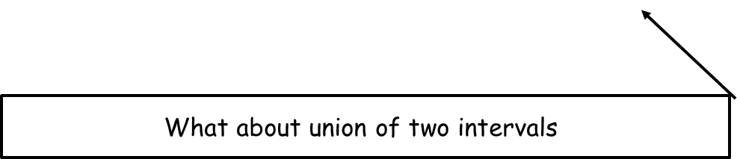
Definition: $VC−dimension$
Fix a hypergraph $H=\left(V,E\right)$
$S⊆V$ is said to be shattered if $\left\{S∩e ∣ e∈E\right\}=2^{S}$
The VC-dimension $dim⁡(H) = \max{ \left\{ \left|S\right|∣ S⊆V S is shattered\right\}}$
What about union of two intervals

Slide 16
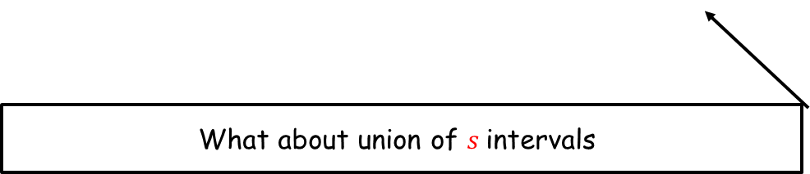
Definition: $VC−dimension$
Fix a hypergraph $H=\left(V,E\right)$
$S⊆V$ is said to be shattered if $\left\{S∩e ∣ e∈E\right\}=2^{S}$
The VC-dimension $dim⁡(H) = \max{ \left\{ \left|S\right|∣ S⊆V S is shattered\right\}}$
What about union of $s$intervals

Slide 17
$$VC−dimension$$
Fix a hypergraph $H=\left(V,E\right)$
$S⊆V$ is said to be shattered if $\left\{S∩e ∣ e∈E\right\}=2^{S}$
The VC-dimension $dim⁡(H) = \max{ \left\{ \left|S\right|∣ S⊆V S is shattered\right\}}$
Example 2: $V$ = points in $R^{2}$, $E$ is induced by half-planes $dim⁡(H)=?$

Slide 18
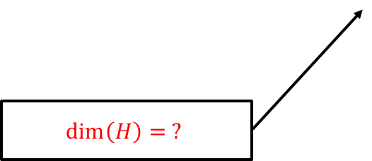
$$VC−dimension$$
Example 3: Points w.r.t half-spaces in $R^{d}$
$$\dim\left(H\right)= ?$$

Slide 19
$$VC−dimension$$
Balls have bounded VC-dimension.
“linearization”
Lift x ∈ ℝᵈ to (x, ||x||²) ∈ ℝᵈ⁺¹
||x-a||² ≤ r²
⇔
||x||² - 2a·x + ||a||² - r² ≤ 0
After lifting, balls become halfspaces.
Notes:
This anticipates the Veronese map in Lecture 2. Point out that the degree-2 polynomial inequality becomes linear after adding monomials.

Slide 20

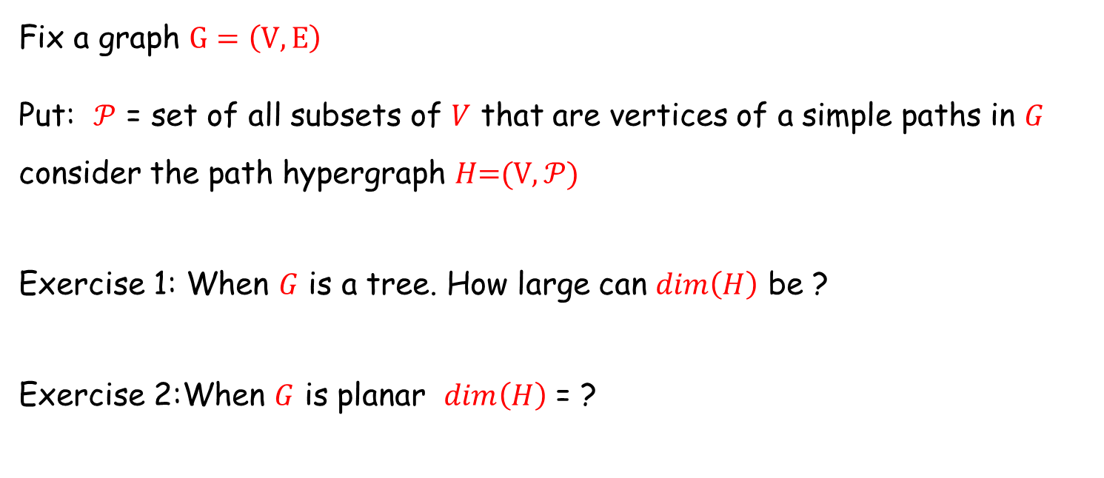
Exercise
Fix a graph $G=\left(V,E\right)$
Put: $𝒫$ = set of all subsets of $V$ that are vertices of a simple paths in $G$
consider the path hypergraph 𝐻=(V$,𝒫$)
Exercise 1: When $G$ is a tree. How large can $dim\left(H\right)$ be ?
Exercise 2:When $G$ is planar $dim\left(H\right)$ = ?

Slide 21

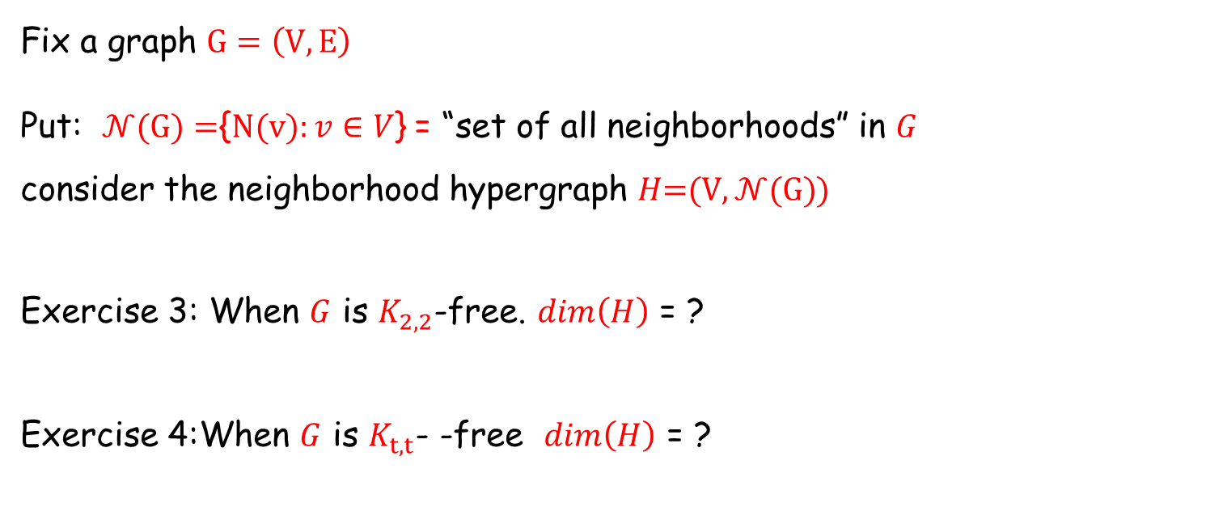
Exercise
Fix a graph $G=\left(V,E\right)$
Put: $𝒩(G)=${$N(v):v∈V$} = “set of all neighborhoods” in $G$
consider the neighborhood hypergraph 𝐻=(V$,𝒩(G)$)
Exercise 3: When $G$ is $K_{2,2}$-free. $dim\left(H\right)$ = ?
Exercise 4:When $G$ is $K_{t,t}$- -free $dim\left(H\right)$ = ?

